Slide 1
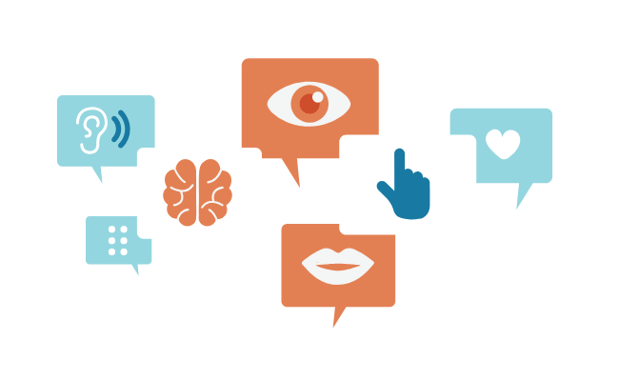
Web Accessibility
It 467
Jianwei Lai
Notes:
https://www.w3.org/WAI/fundamentals/accessibility-intro/

Slide 2
Today’s Content
What is Web Accessibility
W3C standards-WCAG (Web Content Accessibility Guidelines)

Slide 3
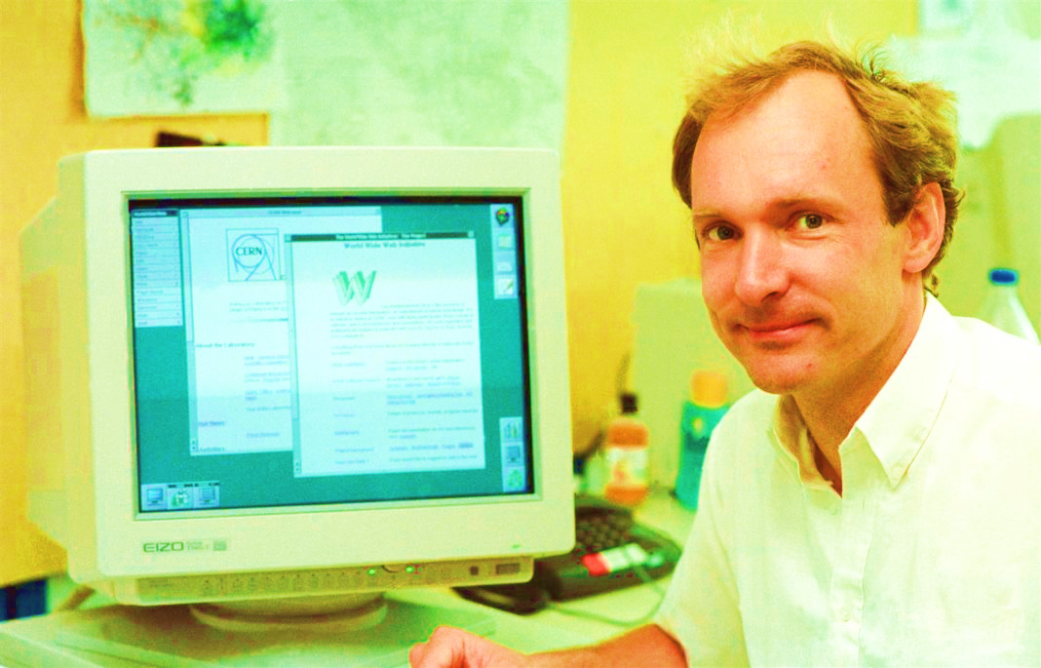
The power of the Web is in its universality. Access by everyone regardless of disability is an essential aspect.
—Tim Berners-Lee
W3C (World Wide Web Consortium) Director
Inventor of the World Wide Web
Notes:
The World Wide Web Consortium is the main international standards organization for the World Wide Web

Slide 4
What is Web Accessibility
Web accessibility means that websites, tools, and technologies are designed and developed so that people with disabilities can use them.
Web accessibility encompasses all disabilities that affect access to the Web, including:
auditory
cognitive
neurological
physical
speech
visual
Notes:
auditory –cannot hear-caption
Cognitive- too complicated words sentences may be hard for people to understand
Neurological-Parkinson's disease
Physical-have no arm
Speech-cannot talk
Visual-cannot see, low vision, color-blindness

Slide 5
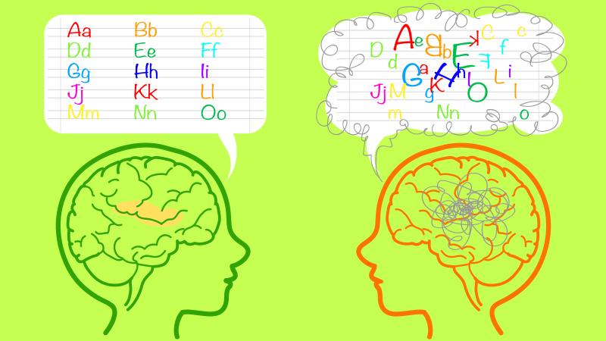
An example -Dyslexia
For people who have dyslexia or have low vision, reduce the reading load.
For example, they may benefit from familiar sans serif fonts, such as Arial or Calibri.
Avoid using all capital letters and excessive italics or underlines.
Include ample white space between sentences and paragraphs.
Notes:
https://support.office.com/en-ie/article/make-your-powerpoint-presentations-accessible-to-people-with-disabilities-6f7772b2-2f33-4bd2-8ca7-dae3b2b3ef25
What can I do to make my slides easier to read for people with dyslexia?

Slide 6
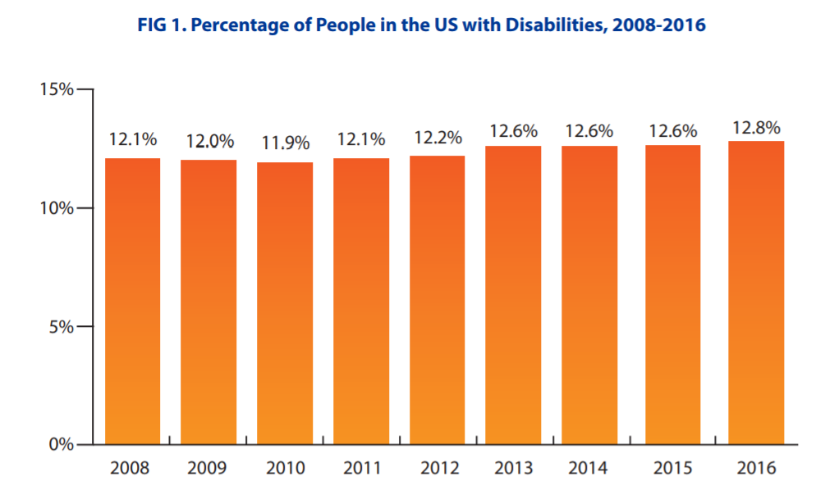
https://disabilitycompendium.org/sites/default/files/user-uploads/2017_AnnualReport_2017_FINAL.pdf
Notes:
About every 8 people, there is one has some sort of disability. A lot of people you cannot leave out.

Slide 7

Web accessibility also benefits people without disabilities
Older people with changing abilities due to ageing
People with “temporary disabilities” such as a broken arm or lost glasses
People with “situational limitations” such as in bright sunlight or in an environment where they cannot listen to audio (e.g., library)
Notes:
https://www.businessinsider.com/how-to-stop-screen-glare-2011-1
Show outlook example, the tiny triangle to show full list of events
The three dots of chrome, users actually do not need to click on the tiny dots, instead the clickable area is much bigger
https://www.instructables.com/id/Laptop-Compubody-Sock/

Slide 8
Related Act
Section 508 of the Rehabilitation Act (1973)
Requires federal agencies to make their electronic and digital content accessible to people with disabilities (Revised-January 2018)
Illinois Information Technology Accessibility Act (2007)
Establishes specific standards and encourages the state of Illinois to address accessibility proactively
Notes:
Being accessible is not only good programming practices, it is actually required by laws
Do you think ISU should follow section 508?

Slide 9
Related Act
Americans with Disabilities Act (1990)
Prohibits discrimination on the basis of disability
Title III of the Americans with Disabilities Act (“ADA”) prohibits discrimination on the basis of disabilities in
places of public accommodations (such as restaurants, movie theaters, schools, day care facilities, recreation facilities, and doctors' offices)
commercial facilities (privately owned, nonresidential facilities such as factories, warehouses, or office buildings)
https://www.ada.gov/ada_title_III.htm
Notes:
Title III prohibits discrimination on the basis of disability in the activities of places of public accommodations (businesses that are generally open to the public and that fall into one of 12 categories listed in the ADA, such as restaurants, movie theaters, schools, day care facilities, recreation facilities, and doctors' offices) and requires newly constructed or altered places of public accommodation—as well as commercial facilities (privately owned, nonresidential facilities such as factories, warehouses, or office buildings)—to comply with the ADA Standards.

Slide 10

Nation’s First Website Accessibility ADA Trial (July 12, 2016)
A visually-impaired individual sued the grocery chain because his screen reader could not process the store locator and coupon sections of the chain’s website.
A Florida district judge found that Winn-Dixie violated Title III of the ADA by not providing a fully accessible public website.
He ordered the grocery chain to make the entire website accessible, even sections that may be run by a third party.
https://www.winndixie.com/?ced69
https://www.youtube.com/watch?v=zeL75HePUXM

Slide 11
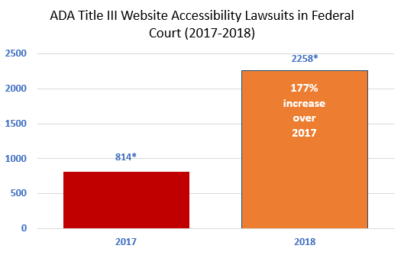
Number Of Federal Website Accessibility Lawsuits Nearly Triple, Exceeding 2250 in 2018

Slide 12
WCAG (Web Content Accessibility Guidelines)

Slide 13
WCAG (Web Content Accessibility Guidelines)
W3C (The World Wide Web Consortium) is the main international standards organization for the World Wide Web.
WCAG
is developed through the W3C process in cooperation with individuals and organizations around the world,
with a goal of providing a single shared standard for web content accessibility that meets the needs of individuals, organizations, and governments internationally.
The WCAG documents explain how to make web content more accessible to people with disabilities.
https://www.w3.org/TR/WCAG20/
https://www.w3.org/WAI/standards-guidelines/wcag/#intro
https://developer.mozilla.org/en-US/docs/Web/Accessibility/Understanding_WCAG
Notes:
Founder: Tim Berners-Lee

Slide 14
WCAG 2.0 and 2.1
WCAG 2.0 was published on 11 December 2008. WCAG 2.1 was published on 5 June 2018.
All requirements (“success criteria”) from 2.0 are included in 2.1. The 2.0 success criteria are exactly the same in 2.1.
There are additional success criteria in 2.1 that are not in 2.0. They are introduced in What’s New in WCAG 2.1.

Slide 15
WCAG 2.0 is ISO/IEC 40500
WCAG 2.0 is approved as an ISO standard: ISO/IEC 40500:2012. ISO/IEC 40500 is exactly the same as the original WCAG 2.0.
ISO: International Organization for Standardization
IEC: International Electrotechnical Commission

Slide 16
WCAG 2.0 Has 4 Principles
POUR
Perceivable
Operable
Understandable
Robust
https://www.w3.org/WAI/WCAG21/quickref/?versions=2.0&showtechniques=11%2C121#principle4

Slide 17
1 Perceivable-Information and user interface components must be presentable to users in ways they can perceive.
1.1 Provide text alternatives for any non-text content so that it can be changed into other forms people need, such as large print, braille, speech, symbols or simpler language.
1.2 Provide alternatives for time-based media.
1.3 Create content that can be presented in different ways (for example simpler layout) without losing information or structure.
1.4 Make it easier for users to see and hear content including separating foreground from background.

Slide 18
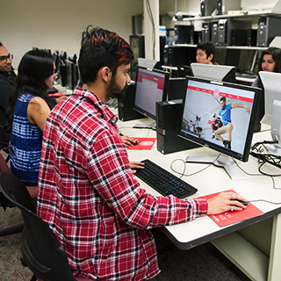

Guideline 1.1 Provide text alternatives for all non-text content
Alt text will be displaced when the image is not available. Screen readers will read the text for blind people.
https://it.illinoisstate.edu/academics/
Notes:
Try Jason’s deli
https://www.jasonsdeli.com/

Slide 19
Screen reader alt attribute accessibility test
Screen readers available at ISU library
JAWS
Zoom Text Magnifier/Reader
Screen readers on phones, turn it on and try it
Voiceover-iPhone
Talkback – Android
ChromeVox-screen reader on Chrome
Screen reader alt attribute accessibility test
https://www.youtube.com/watch?v=NvqasTVoW98
Notes:
https://library.illinoisstate.edu/services/accessible-assistive/

Slide 20
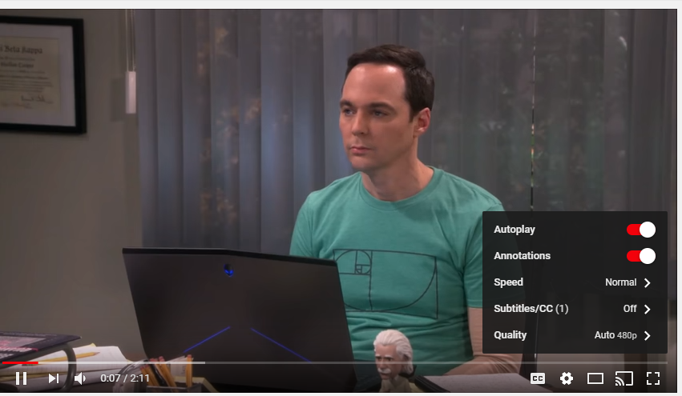
Guideline 1.2 Provide synchronized alternatives for multimedia
Synchronized captioning with audio and video presentations
https://www.youtube.com/watch?v=cxMaFsDv8Pc

Slide 21
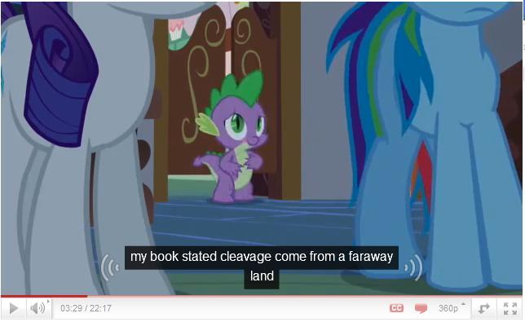

YouTube Automatic Caption FAIL
AI has a lot room for improvement for translation
https://knowyourmeme.com/memes/youtube-automatic-caption-fail

Slide 22
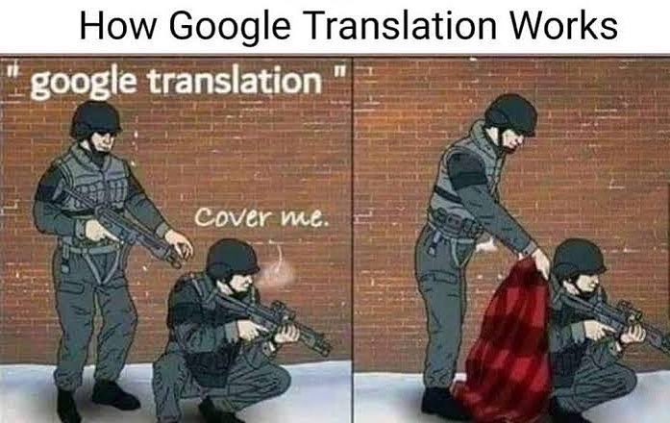

Slide 23
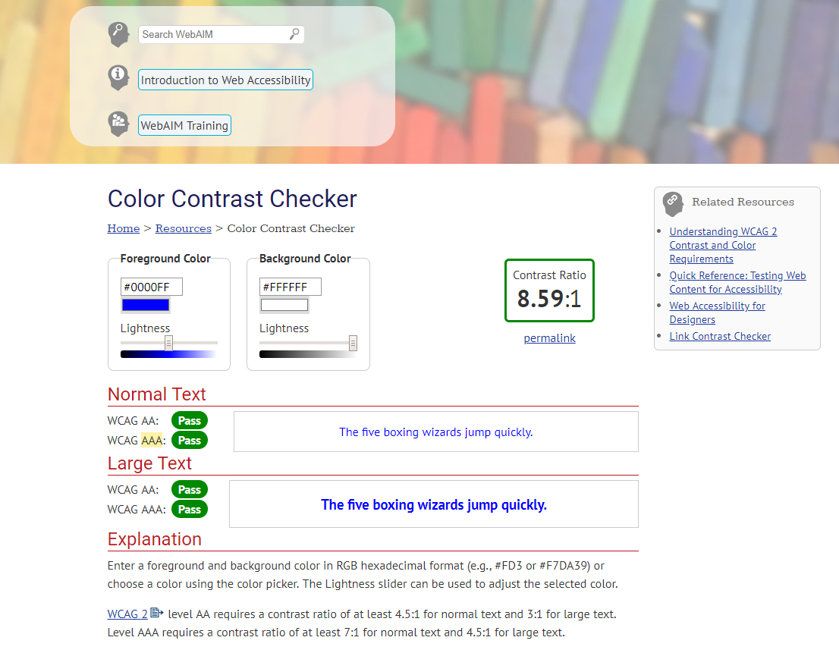
1.4 Make it easier for users to see and hear content including separating foreground from background
Color Contrast Checker
WCAG: Web Content Accessibility Guidelines
https://webaim.org/resources/contrastchecker/
Notes:
When we become older, we are less sensitive to color contrast
https://www.youtube.com/watch?v=3f31oufqFSM

Slide 24
2 Operable
2.1 Make all functionality available from a keyboard.
2.2 Provide users enough time to read and use content.
2.3 Do not design content in a way that is known to cause seizures.
2.4 Provide ways to help users navigate, find content, and determine where they are.
Notes:
Users must be able to control UI elements (e.g. buttons must be clickable in some way — mouse, keyboard, voice command, etc.).

Slide 25
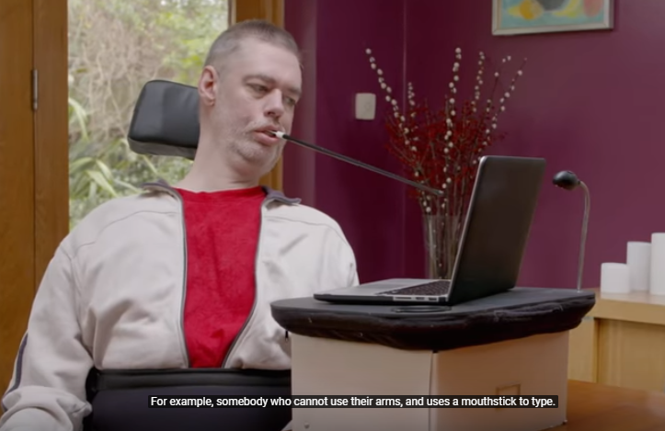
2.1 Make all functionality available from a keyboard
For example, you can navigate with the Tab key
Notes:
https://www.youtube.com/watch?v=20SHvU2PKsM

Slide 26
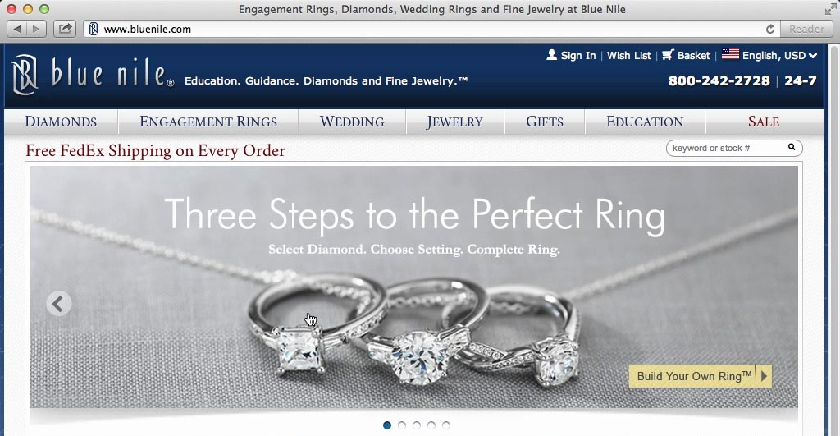
2.2 Provide users enough time to read and use content
For example, animated, moving or scrolling content introduces a time limit on a users ability to read content
Automatic Image Sliders or Carousels
Do you see any potential accessibility issues?
https://conversionxl.com/blog/dont-use-automatic-image-sliders-or-carousels/
https://conversionxl.com/blog/dont-use-automatic-image-sliders-or-carousels/

Slide 27
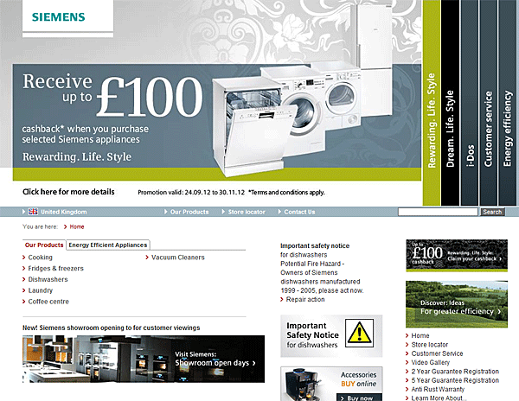
Auto-Forwarding Carousels and Accordions Annoy Users and Reduce Visibility
Jakob Nielsen (yes, the usability guru) confirms this in tests. They ran a usability study where they gave users the following task: “Does Siemens have any special deals on washing machines?”.
The information was on the most prominent slide. The users could not see it – totally hit by banner blindness.
Nielsen concludes the sliders are ignored.
https://www.nngroup.com/articles/auto-forwarding/

Slide 28
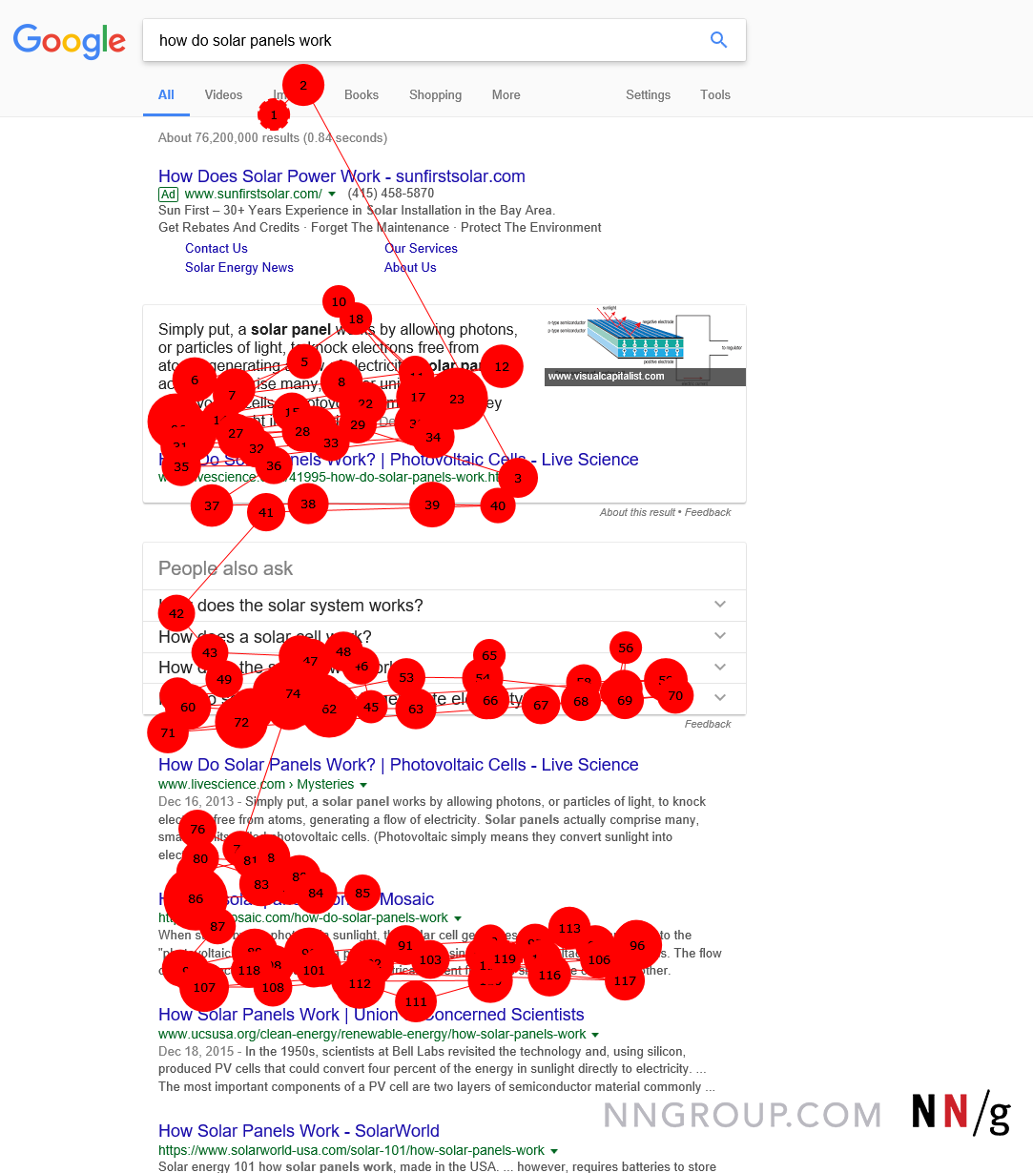
Banner blindness
Banner blindness is a long-known web user behavior.
it describes people’s tendency to ignore page elements that they perceive (correctly or incorrectly) to be ads.
Notes:
https://www.nngroup.com/articles/banner-blindness-old-and-new-findings/
Do you think static slide show is going to be better?

Slide 29
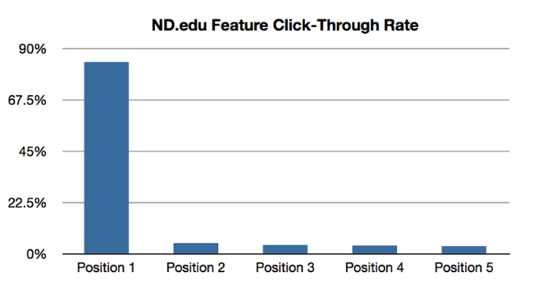
Image Carousels – Why You Shouldn’t Use Them
Notre Dame University tested their carousel.
Only 1% of total visitors clicked through from the carousel.
Majority of these visitors (84%) interacted with only the first slide of the carousel.
Notes:
https://vwo.com/blog/image-slider-alternatives/

Slide 30
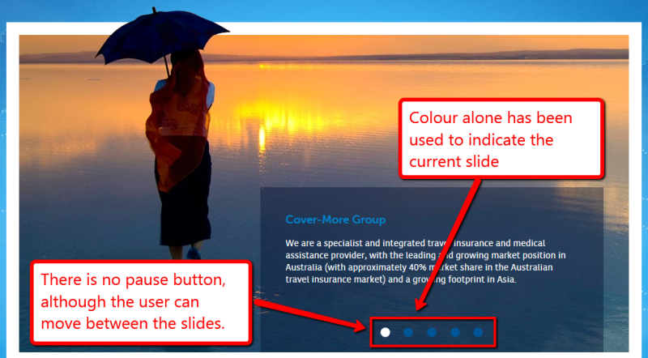
The Unbearable Inaccessibility of Slideshows
https://www.sitepoint.com/unbearable-accessible-slideshow/
https://www.nngroup.com/articles/designing-effective-carousels/
Notes:
Wait until the image shows again

Slide 31
The Unbearable Inaccessibility of Slideshows
The biggest problem with these slideshows is that they cannot be paused by the user.
The next most serious problem is that neither is keyboard accessible.

Slide 32
2.3 Do not design content in a way that is known to cause seizures
Some people are susceptible to seizures caused by strobing, flickering, or flashing effects.
Science-fiction style Flash objects, horror movie previews, and cheap-looking banner ads are among the worst offenders.
According WCAG, in general, if the content flashes more than three times per second, is notably large (a small animating image would not cause a seizure), has bright contrast in the flashes, it may cause a seizure and should be avoided.

Slide 33
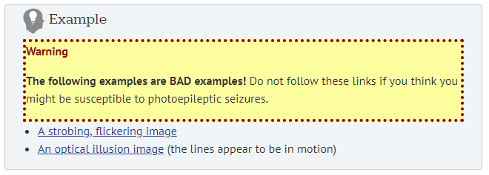
https://webaim.org/articles/seizure/

Slide 34
3 Understandable
3.1 Make text content readable and understandable.
3.2 Make Web pages appear and operate in predictable ways.
3.3 Help users avoid and correct mistakes.
https://developer.mozilla.org/en-US/docs/Web/Accessibility/Understanding_WCAG/Understandable
https://www.w3.org/TR/WCAG20/

Slide 35
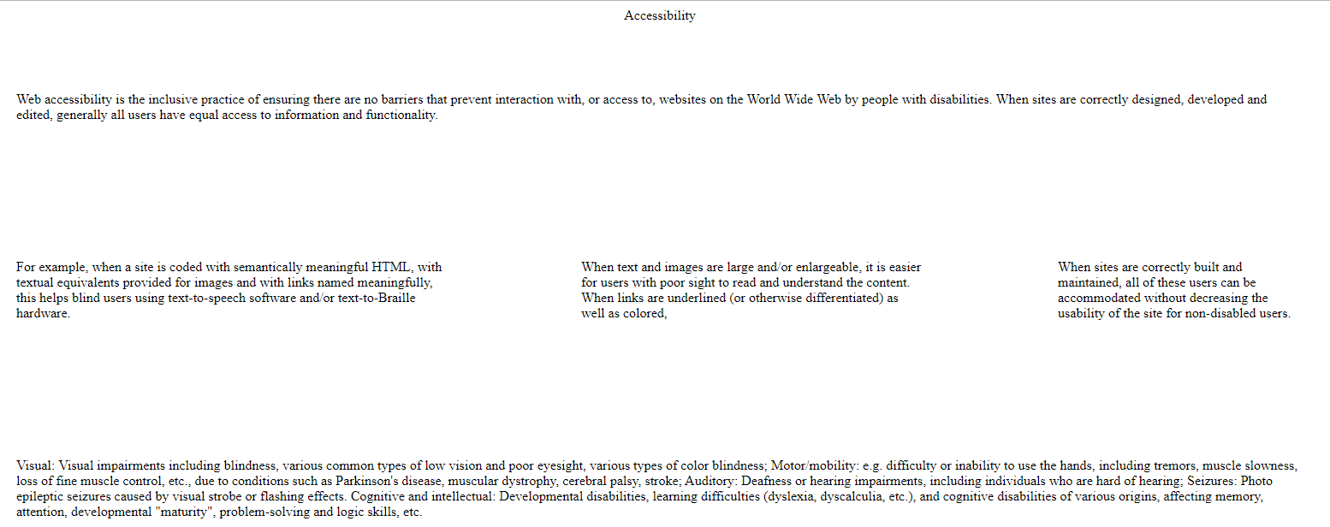
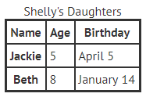
Creating Accessible Tables
Layout Tables vs. Data Tables
Do not use a table for website layout. It will confuse screen readers. The website will be read out as a table.
https://webaim.org/techniques/tables/
Notes:
<!DOCTYPE html>
<html>
<head>
<title>Page Title</title>
</head>
<body>
<table cellpadding="80" cellspacing="0" border="0">
<caption>Accessibility</caption>
<tr>
<td colspan="3">Web accessibility is the inclusive practice of ensuring there are no barriers that prevent interaction with, or access to, websites on the World Wide Web by people with disabilities. When sites are correctly designed, developed and edited, generally all users have equal access to information and functionality.</td>
</tr>
<tr>
<td>For example, when a site is coded with semantically meaningful HTML, with textual equivalents provided for images and with links named meaningfully, this helps blind users using text-to-speech software and/or text-to-Braille hardware.</td>
<td>When text and images are large and/or enlargeable, it is easier for users with poor sight to read and understand the content. When links are underlined (or otherwise differentiated) as well as colored, </td>
<td>When sites are correctly built and maintained, all of these users can be accommodated without decreasing the usability of the site for non-disabled users.</td>
</tr>
<tr>
<td colspan="3">Visual: Visual impairments including blindness, various common types of low vision and poor eyesight, various types of color blindness;
Motor/mobility: e.g. difficulty or inability to use the hands, including tremors, muscle slowness, loss of fine muscle control, etc., due to conditions such as Parkinson's disease, muscular dystrophy, cerebral palsy, stroke;
Auditory: Deafness or hearing impairments, including individuals who are hard of hearing;
Seizures: Photo epileptic seizures caused by visual strobe or flashing effects.
Cognitive and intellectual: Developmental disabilities, learning difficulties (dyslexia, dyscalculia, etc.), and cognitive disabilities of various origins, affecting memory, attention, developmental "maturity", problem-solving and logic skills, etc.</td>
</tr>
</table>
</body>
</html>

Slide 36
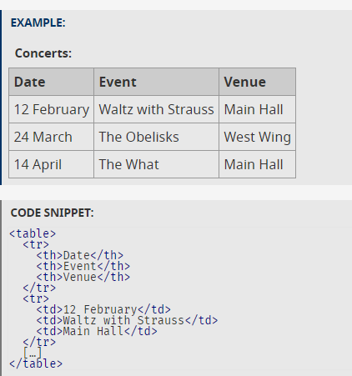
HTML markup for tables
Accessible tables need HTML markup that indicates header cells and data cells and defines their relationship.
Assistive technologies use this information to provide context to users.
Header cells must be marked up with <th>, and data cells with <td> to make tables accessible.
https://www.w3.org/WAI/tutorials/tables/one-header/

Slide 37
Why it is necessary to define the language of your page?
<html lang=”en”>
Assistive technology would be able to represent information more accurately if you define your page’s language.
Your site will also be displayed more accurately in search results. Search engines such as Google provide their users a way to search for websites in a particular language.

Slide 38
4 Robust
Maximize compatibility with current and future user agents, including assistive technologies.
The content must be developed using well-adopted web standards that will work across different browsers, now and in the future.

Slide 39
Online Resources
WCAG Overview (https://www.w3.org/WAI/intro/wcag)
WebAIM (http://webaim.org/)
Web Accessibility Evaluation Tool (WAVE by WebAIM) (http://wave.webaim.org/)
Functional Accessibility Evaluator (FAE) by University of Illinois (https://fae.disability.illinois.edu/)
Dos and Don’ts on Designing for Accessibility Posters (https://accessibility.blog.gov.uk/2016/09/02/dos-and-donts-on-designing-for-accessibility/)

Slide 40
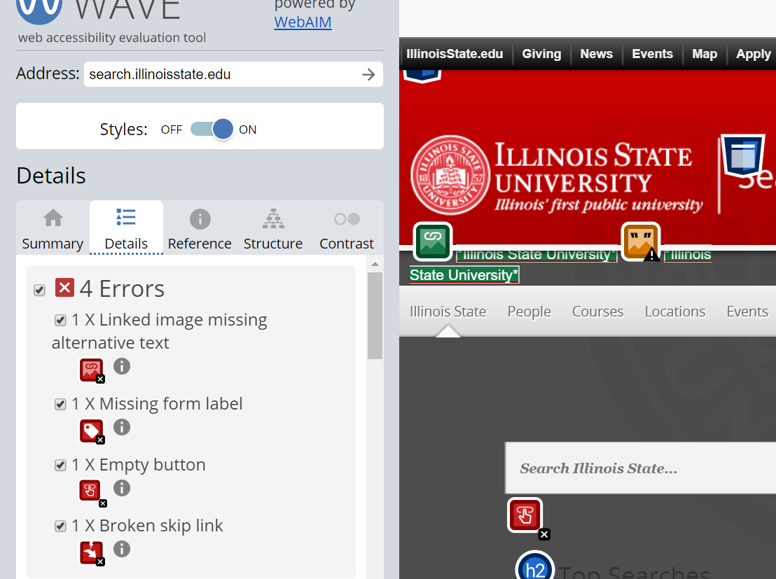
Try search.illinoisstate.edu with Web Accessibility Evaluation Tool
http://wave.webaim.org/

